Slide 1
Font: Arial
Fon size:
Title 24
Subtitle 10
Content 8
Footnotes 5

Slide 2
Content Page

Slide 3
Executive Summary yupeng
Portfolio allocation
Key Rationale
Risk return analysis

Slide 4

Client Profile(15%) 02
Client Profile
Risk Appetite and Tolerance*
Investment Profile
Personal Details | 38 Years Old Hong Kong People
Stage of Life | Working Phase
Net Worth | USD 95million
Dependents | 1 Spouse (32yo) & 2 Children (5yo)
Liquidity Needs | Hobbies & Lifestyle Expenses Children’s Education
Investment Objective | Higher financial efficiency Capital appreciation Education funding
Investment Horizon | Approximately 27 Years**
Return Objective | Moderate Returns： 5-8%
Risk Objective
Mr. Scott Seng
Founder & CEO of LionDash
**Assuming retirement at the age of 63, the average retirement age in Singapore as of 2025
*rated on a scale of 1 (very low risk tolerance) to 5 (very high risk tolerance)
Investment objectives
Key insights and investment needs
Risk-return assessment

Slide 5
Convincing clients(10%) 02
Portfolio allocation
Key Rationale
Risk return analysis

Slide 6
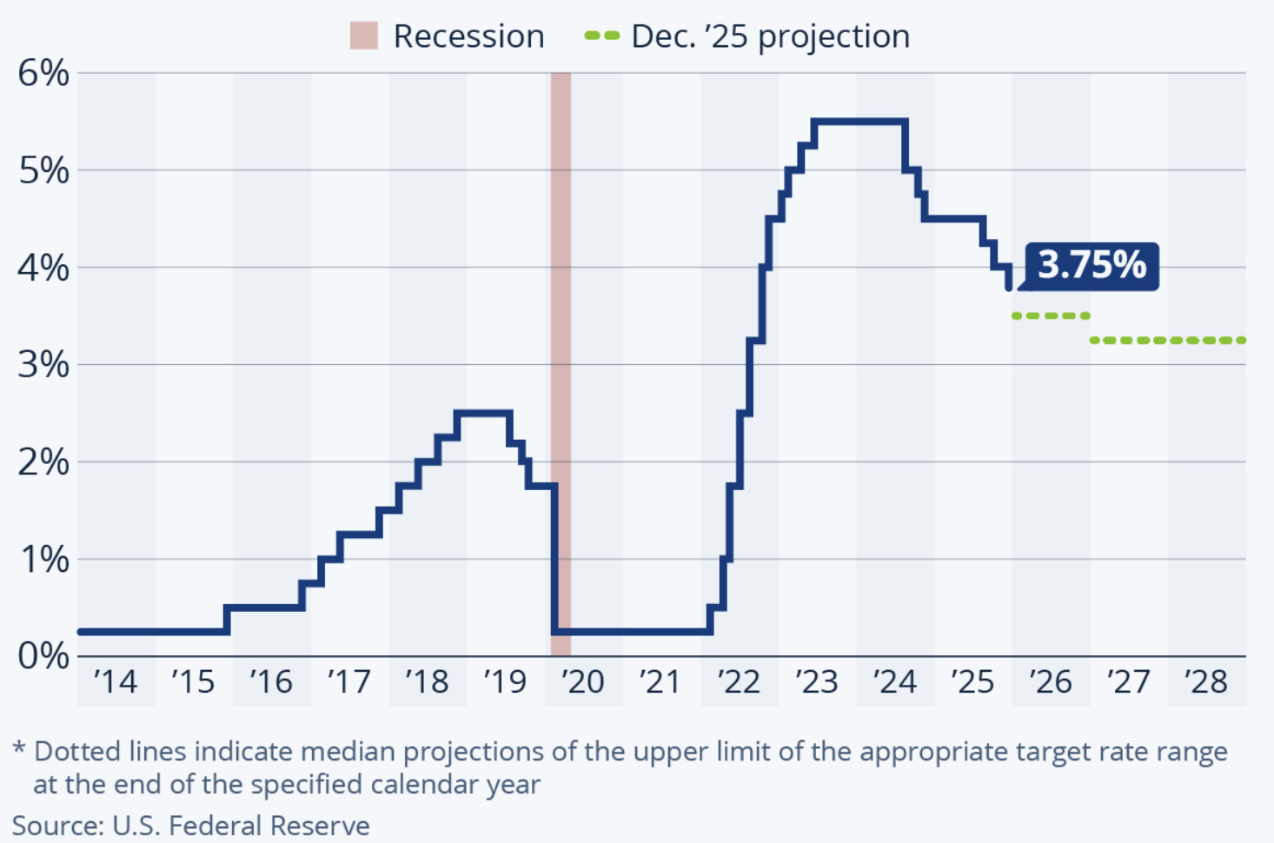

Macroeconomic Themes
Riding the Rate Cut Tailwinds
Continued Geopolitical & Political Uncertainty
US Federal Funds rate has declined 150 bps from its cycle peak, now around 3.75%
Markets are pricing an additional 50-100bps of cuts in 2026 according to CME FedWatch.
Inflation in the US and Europe is trending lower but remains above 2% targets
Soft landing scenario remains base case
US-China strategic competition --> Technology controls, semiconductor restrictions
US-China strategic competition --> Technology controls, semiconductor restrictions
US-China strategic competition --> Technology controls, semiconductor restrictions
Supportive environment for quality income assets such as Investment Grade Bonds and diversified global equities.
Dispersion in Equity Valuations & Structural Themes
Energy Transition & Private Credit

Slide 7
Global Economic Outlook
Equities
Fixed Income
Alternative Investments
Foreign Exchange

Slide 8
Transition 02

Slide 9
Portfolio
Asset Allocation
Risk and Return
Equity positioning
Fixed income positioning

Slide 10
SAA and TAA Formulation
Portfolio allocation
Key Rationale
Risk return analysis

Slide 11
Credit Solutions yupeng
Portfolio allocation
Key Rationale
Risk return analysis

Slide 12
Risk Management yupeng
Portfolio allocation
Key Rationale
Risk return analysis

